Slide 1
Introduction to Scala
CS 671

Slide 2
Scala in a nutshell
Stands for Scalable Language (say: skah’-lah)
Java-like language
Unifies two programming paradigms:
object-oriented programming
functional programming
Rich in features, concurrency support
Statically-typed, yet flexible
Notes:
Basically an outline for this set of slides

Slide 3
Scala’s relationship to Java
Inspired by Java, with similar syntax
Compiles to Java bytecode
Meaning it is interoperable w/ Java code
Runs on the Java Virtual Machine (jit, gc, concurrency…)

Slide 4
Scala Unifies O-O and Functional
Object-oriented: Every value is an object
Functional: Every function is a value
➔ Every function is an object
Keeps basic syntax very lean & flexible
Let’s look at a few examples (just a taste!)
Initialization of a Map
Syntax for testing
Operators defined on multiple types

Slide 5
Initialization of a Map
Python: { "Dhm": 1463, "Dvr": 3051, "Ptm": 2159 }
Syntax is rigidly specified to accommodate this
Scala: Map("Dhm" -> 1463, "Dvr" -> 3051, "Ptm" -> 2159)
Syntax is much more flexible
Only parentheses and commas are fixed
Map is just a regular class name
-> is not part of the syntax of the language

Slide 6
What’s up with the operator?
Map("Dhm" -> 1463, "Dvr" -> 3051, "Ptm" -> 2159)
-> is…
not part of the syntax of the language
a method with a symbolic name
an infix operator (instead of "Dhm".->(1463) )
not a method of any given class
actually compiled as new ArrowAssoc("Dhm").->(1463)

Slide 7
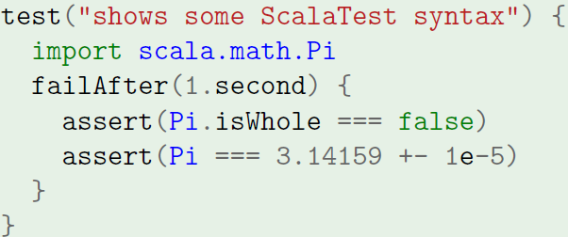
Syntax for testing
test & failAfter are not part of Scala
They use tricks from functional programming
These methods are curried (multiple argument lists)
The code in braces is passed to them (lazy evaluation)
=== & +- are methods (with symbolic names)
second is a method w/ no arguments
Methods work b/c of implicit conversions

Slide 8
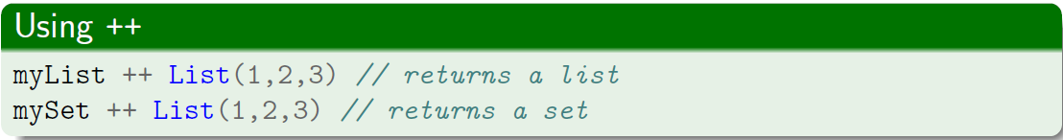
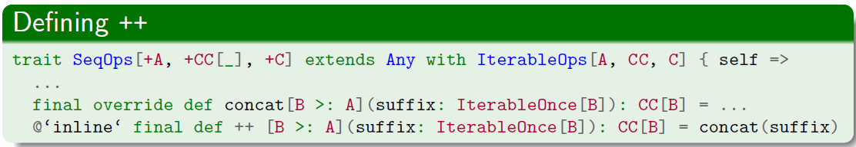
Operators defined on multiple types
This ++ concatenation operator is easy to use
But it’s very complicated to write

Slide 9
Why?
All these powerful features…
can result in incomprehensible code
should be used sparingly, appropriately
Scala aims to push complexity into libraries
Point: make application code easy to keep
clean, elegant (no ugly hacks)
stylistically consistent (no poor style)
relatively simple (no unnecessary complexity)

Slide 10
Course approach
Start with simpler application-level features
Ease into more complex library-level features
Even if you never write library code, still…
can gain understanding of how features work
in others’ code, so can use/debug it effectively
behind own code, so can be aware of (in)efficiency
should learn to use in proper circumstances

Slide 11
Scala in a nutshell (Outline)
Stands for Scalable Language (say: skah’-lah)
Java-like language
Unifies two programming paradigms:
object-oriented programming
functional programming
Rich in features, concurrency support
Statically-typed, yet flexible
Notes:
Basically an outline for this set of slides

Slide 12
Scala is rich in features
Scala favors a functional programming style
What does this mean?
Imperative programming relies on…
(mutable) variables, assignment
sequential composition
Functional programming relies on…
expressions & expression evaluation
functional composition, recursion
Physical hardware: addresses, memory, program counter…
Mathematical ideas: logic, collections, relations…

Slide 13
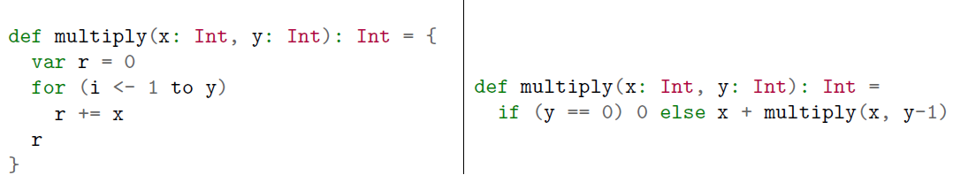
Functional composition/recursion
Repetition in… comes from…
Imperative programming → repetition (loops)
Repetition doesn’t change a function or expression 2 + 2, 2 + 2, … sqrt(4), sqrt(4), sqrt(4)…
Requires loops w/ mutable variables to get results
Functional programming → recursion
Recursion builds result from functions/expressions
Notes:
Note, multiply written inefficiently, should be rewritten (tail-recursive)

Slide 14
Scala is rich in features
Features found in functional programming
Persistent data structures
Anonymous functions (lambdas)
Higher-order functions (functions become args)
Currying (provide partial argument list)
Lazy evaluation
Closures (package your scope how you like)
Pattern-matching
Functors, monads, …

Slide 15
Scala is statically-typed, flexible
Full set of collections (next slides) split into…
Immutable collections
Mutable collections
Types can be specified more flexibly than you may have thought possible (hint on last slide)

Slide 16
Scala’s Immutable collections

Slide 17
Scala’s Mutable collections

Slide 18
Scala’s Built-in Type Hierarchy

Slide 19
Remember: Course approach
Start with simpler application-level features
Ease into more complex library-level features
Even if you never write library code, still…
can gain understanding of how features work
in others’ code, so can use/debug it effectively
behind own code, so can be aware of (in)efficiency
should learn to use in proper circumstances

